Slide 1
Mstack review

Slide 3
Expressions conversion and evaluation using stack

Slide 4
Types of expressions
Infix expression:The expression of the form a op b. When an operator is in-between every pair of operands. Ex: a+b*c
Postfix expression:The expression of the form a b op. When operands are followed by respective operator. abc*+
Prefix expression:The expression of the form op a b op. When an operator is followed for every pair of operands. +*cba

Slide 6
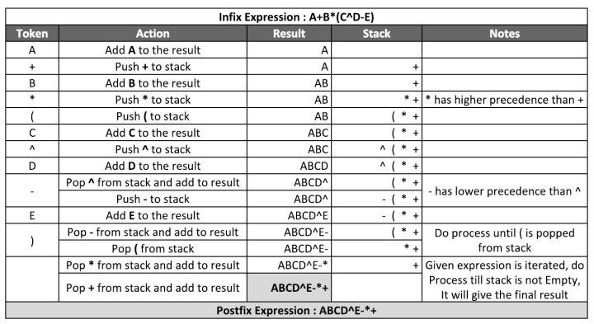

Slide 7
Infix to postfix conversion example

Slide 8
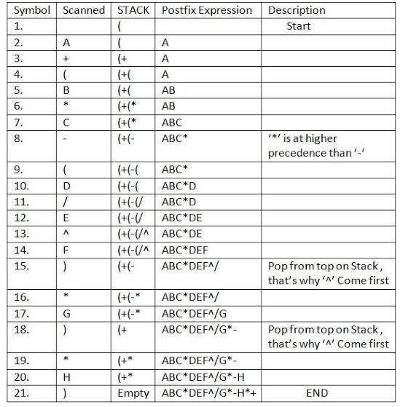

Slide 9
Stack Implementation using Array
#include<iostream.h>
#include<conio.h>
#include<process.h>
enum Boolean{FALSE,TRUE};
typedef char elt;
class stack
{ int top;
elt a[10];
int maxsize;
public:
stack(int size);
Boolean Isfull();
Boolean Isempty();
void push(elt x);
elt pop();
void display();
elt peek(){ if (top!=-1)
return a[top]; else return -1;}
};

Slide 10
stack::stack(int size)
{
maxsize=size;top=-1;
}
Boolean Stack::Isfull()
{
if(top==maxsize-1)
return TRUE;
return FALSE;
}
Boolean Stack::Isempty()
{ if(top==-1)
return TRUE;
return FALSE;
}

Slide 11
void stack::push(elt x)
{ if(Isfull())
cout<<"Stack is full \n";
else
a[++top]=x;
}
elt stack::pop()
{
if(Isempty())
{cout<<"stack is empty\n"; return -1;}
else{
cout<<"deleted element is"<<(a[top]);
return (a[top--])
}}
void stack::display()
{ if(Isempty())
cout<<"stack is empty\n";
else
for(int i=top;i>-1;i--)
cout<<a[i];
}

Slide 12
int isOperator(char input)
{
switch (input) {
case '+':
return 1;
case '-':
return 1;
case '*':
return 1;
case '^':
return 1;
case '%':
return 1;
case '/':
return 1;
case '(':
return 1;
}
return 0;
}
int isOperand(char input)
{
if (input >= 65 && input <= 90
|| input >= 97 && input <= 122)
return 1;
return 0;
}
int Prec(char input)
{
switch (input) {
case '+':
case '-':
return 2;
case '*':
case '%':
case '/':
return 4;
case '^':
return 5;
default:
return 0;
}
}

Slide 13
void infixtopostfix(char *infix)
{int i=0; Stack s(10); int k=0;
char postfix[strlen(infix)];
for(; infix[i]!=‘\0’;i++)
{
if(isOperand(infix[i]))
postfix[k++]=infix[i];
else if (infix[i]==‘(‘) s.push(infix[i]);
else if(infix[i]==‘)’) {
while(s.peek()!=‘(‘) postfix[k++]=s.pop();
s.pop();}
else if isOperator(infix[i])
{
while((prec(s.peek()) >=prec(infix[i]))
postfix[k++]=s.pop();
s.push(infix[i]);
}
}
while(s.peek()!=-1) postfix[k++]=s.pop();
postfix[k]=‘\0’;
puts(postfix); }

Slide 14
Main program
void main(){
char infix[20];
cout<<“Enter infix expression”;
gets(infix);
Infixtopostfix(infix);
}

